Slide 1
Nutrition Calculator for Theme Park Snack Shop App Usability Study
November 2021
Team
Adrienne Duchnowski

Slide 2
Table of Contents
Section 1 Study Details
Section 2 Themes
Section 3 Insights & Recommendations
Section 4 Next Steps

Slide 3
Study Details

Slide 4
Project Background
We are integrating a nutrition calculator into the ordering app for a theme park snack shop. We would like to allow theme park goers to mindfully choose their snacks that accommodates their nutritional goals, without detracting from their overall theme park experience.

Slide 5
Study Details
Research Questions
Participants
Methodology
How do users interact with and use the nutritional/health filters prior to browsing?
What are some of the main macro/micro nutrients users might be interested in when placing an order?
How do users feel about the nutritional summary presented in the dashboard?
5 participants
3 females, 2 males.
4 individuals between the ages of of 20-40, and one above 65.
20 minutes
2 Virtual, 3 In-Person
Usability study
Users asked to place a snack order on a low fidelity prototype.

Slide 6
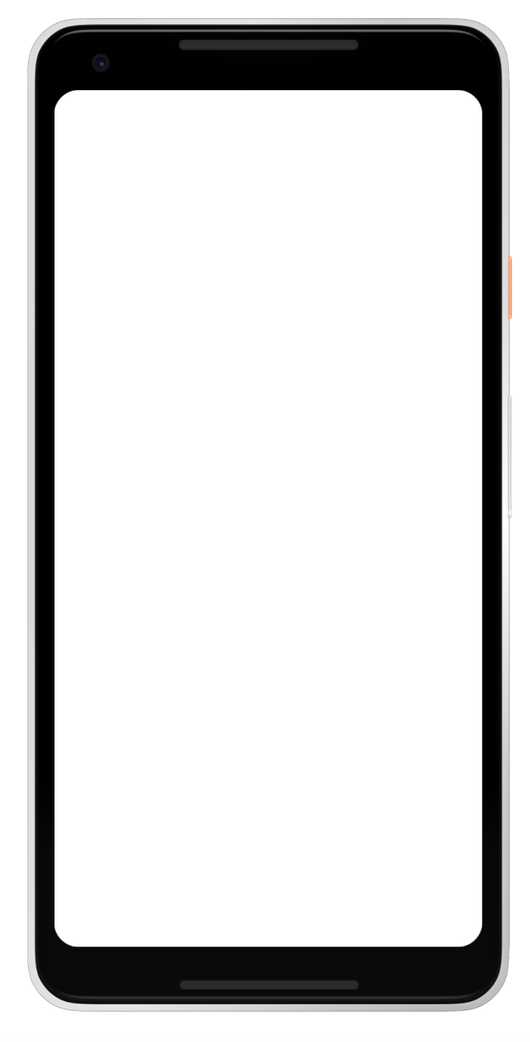
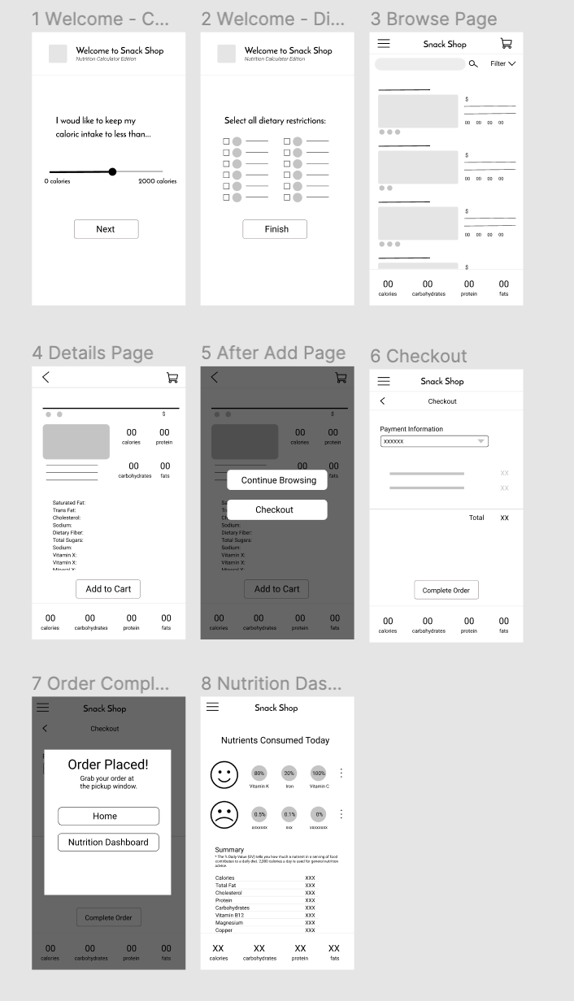

Prototype / Design Tested
When the user opens their food app, they will be taken through a series of screens at the start of their order that allows them to put in certain nutritional preferences to bring up a more personalized browse list.
https://www.figma.com/file/XUjQVCfWsQOGLSjP28kwpr/Nutrition-Calculator-for-Theme-Park-Snack-Shop?node-id=0%3A1

Slide 7
Prototype / Design Tested

Slide 8
Themes

Slide 9
Theme #1
Many participants wanted a more detailed and inclusive filter option at the beginning of the app.
4 out of 5 participants seemed a little dissatisfied with the information provided by the calorie slider.
There was also some confusion about how to interpret the slider’s value.
”It would be nice to limit the amount of sugars I take in.” (Participant E)
a

Slide 10
Theme #2
Most participants struggled between the browse page to get to the shopping cart for check out
2 out of 5 participants wanted to be directly to add from the browse screen.
All participants had to be told directly to click into the browse item to get the add to cart option before going to check out.
”It would be great to quickly add to my cart since I already know what I want” (Participant D)

Slide 11
Theme #3
The check out screen seemed to stump some of our users.
2 of 5 participants wanted to see a summary of what they were ordering so they can make changes prior to checkout.
2 of 5 participant thought it was strange to have payment information at the top.
”I would like to see a nutrition summary of my cart before I order” Participant A
a

Slide 12
Insights & Recommendations

Slide 13
Research insights
Dissatisfaction with Filters
Difficulty Getting to Checkout
Checkout Screen seems to skip a step
Dashboard summary Difficult to Understand
Users seemed to want more details and options in their filters.
Users want an easy way to add to cart for snacks they are already familiar with.
There needs to be detailed summaries provided, and the user should not be asked payment information right away.
Dashboard needs an overhaul.

Slide 14
Recommendations
Add more details into the Filter screens, with better wording. Also include a Sugar Filter.
Include an Add to Cart button for each of the items on the browse screen.
Provide a summary of nutrients at check out screen, and bring payment information at the bottom of check out screen.
Dashboard designed should be reworked in the next iteration.

Slide 15
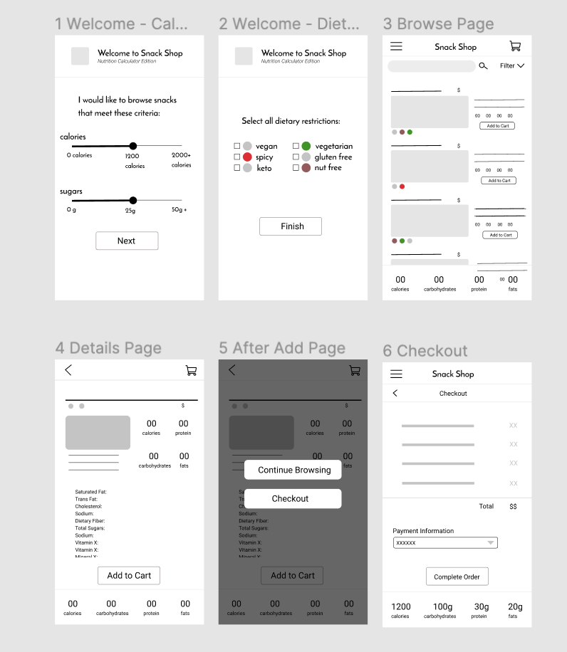
Theme #1
We updated the filter section to contain clearer text, and additional features.
a

Slide 16
Theme #2
We added an “Add to Cart” button so it’s easier to add to cart without clicking into the item.

Slide 17
Theme #3
We moved the payment to the end so the user can review their cart, as well as total nutritional summaries before completing their order.
a

Slide 18
Next Steps:
Retest the updated prototype
Revamp the Dashboard based on feedback

Slide 19
Thank you!

